Slide 1
Who Makes the Big Bucks in Tech in the U.S.?
Anna Dai
IDS702 Final Project

Slide 2
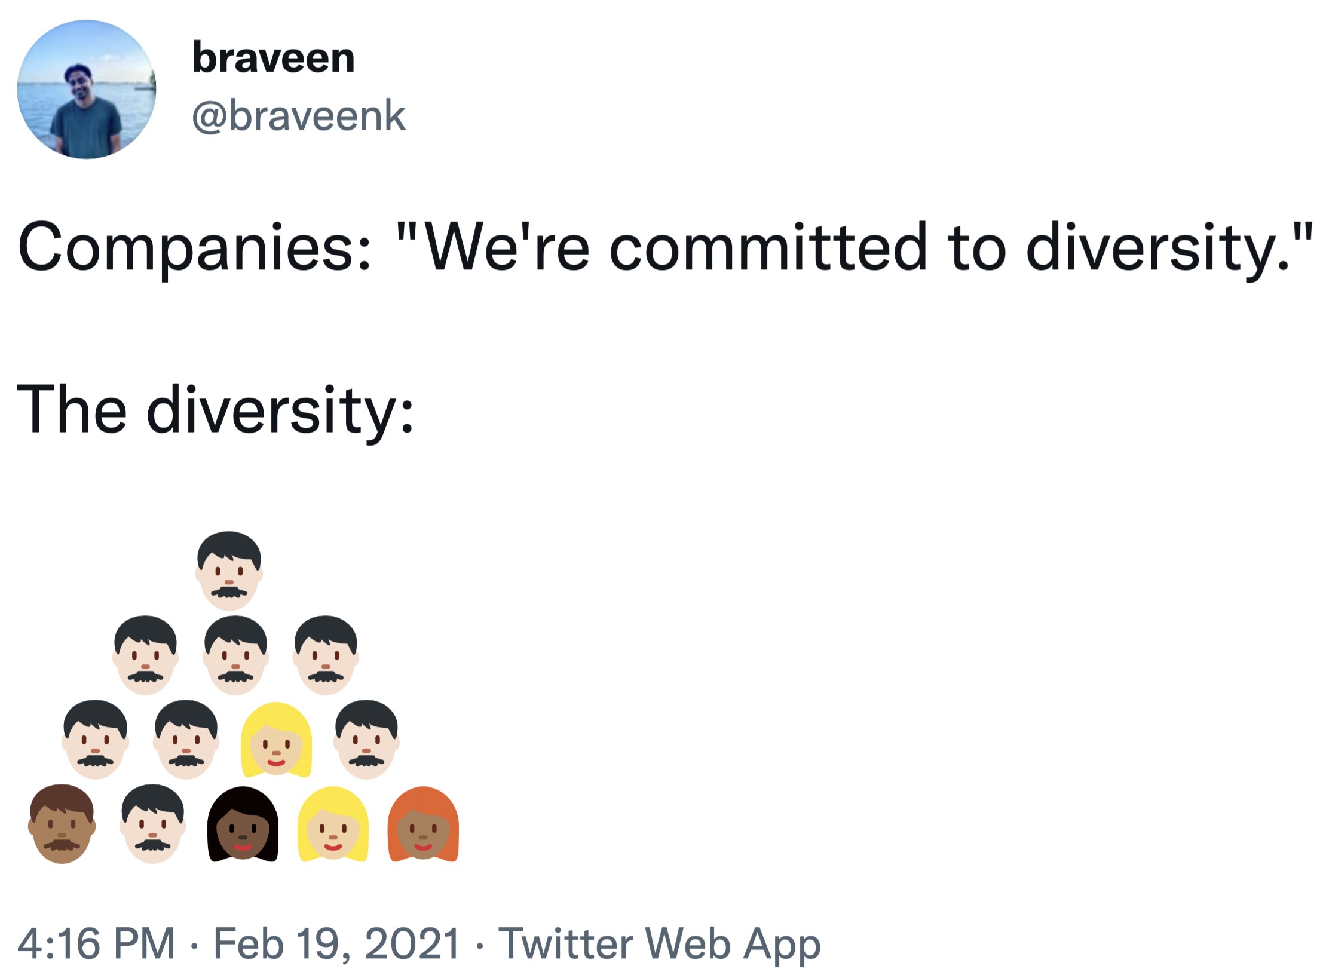
Goal
Inspiration
Issues
Lack of data
Companies’ personnel data are well guarded secrets
Salary information are private
Scraped data on top public companies and their leaders
But no response variable
Notes:
To analyze diversity in successful positions and success is closely correlated with demographic variables

Slide 3

Data Set
to the Rescue
2021 Stack Overflow Annual Developer Survey
Nearly 80,000 responses from around the world
Subset for professional developers who are currently employed in the U.S.
Not representative of the general workforce – only Stack Overflow users
Unreliable data inputs
Leadership
Compensation
Logistic regression
Highly imbalanced data
Linear regression
Next best thing
Chosen one

Slide 4
Modeling Process
Data Cleaning
Missing Data Imputations
EDA
Linear Model Fitting
Hierarchical Model Fitting
Interpretations

Slide 5


Data Cleaning
Response Variable
Predictors
Multiple related columns:
CompTotal
CompFreq
Currency
ConvertedCompYearly
Mistakes when entering data
Set lower bound (0.25%)
Corrected upper bound mistakes
Currency mistakes
Entered yearly pay as weekly
Drop unrelated columns
Single-select multiple choice
Multi-select multiple choice
Collapse into single-select
Convert into multiple binary
Collapsing variable levels
Correlated variables
Definitely Losing It
Use log of $ConvertedCompYearly$

Slide 6

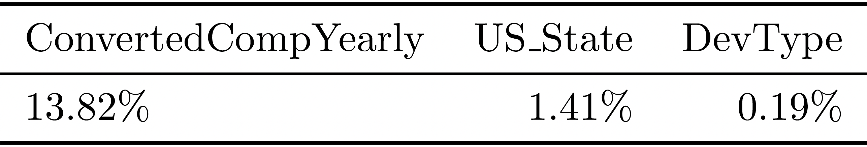
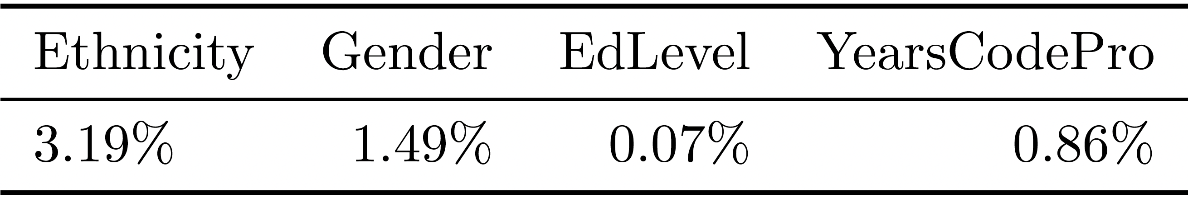
Missing Data
Multiple Imputations
9647 total observations
0.07% - 13.82% missing data
Dropped observations with N/A values for now

Slide 7
EDA
Log Transformation
Distribution by State

Slide 8
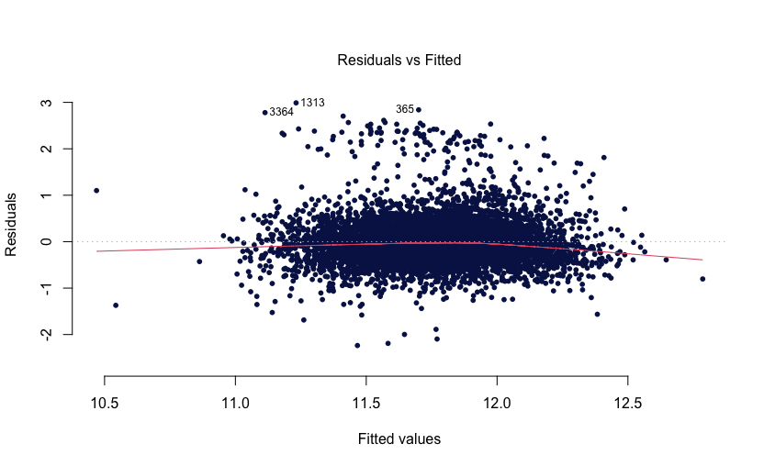
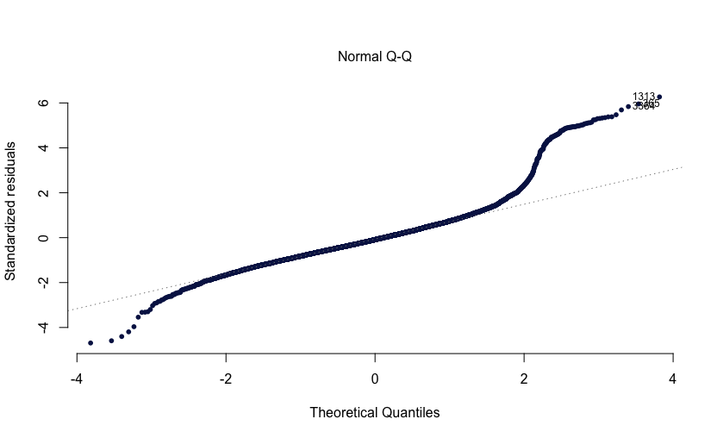
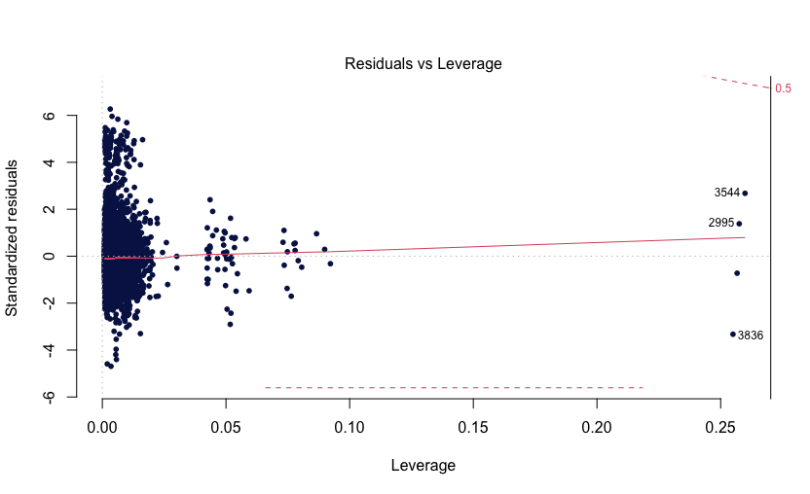
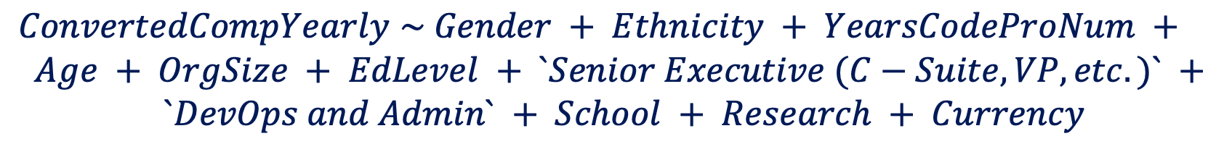
Linear Model Fitting
Null Model
Gender and Ethnicity only
Parameters
BIC
Direction = both
Full Model
All non-location predictors
Resulting Model
$ConvertedCompYearly$ $\sim Gender + Ethnicity + YearsCodeProNum +$
$$Age + OrgSize + EdLevel + `Senior Executive (C−Suite, VP, etc.)` +$$
$$`DevOps and Admin` + School + Research + Currency$$
Notes:
Dauren

Slide 9


Hierarchical Model Fitting
Choice of Levels
No Hierarchy
AIC = 10107.1
Random Intercept
AIC = 9761.29
?
$$>$$
$$>$$
No Hierarchy vs. Random Intercept
*
* Difference from above due to ML vs. REML refitting
Use hierarchical, random-intercept model by $US_State$

Slide 10
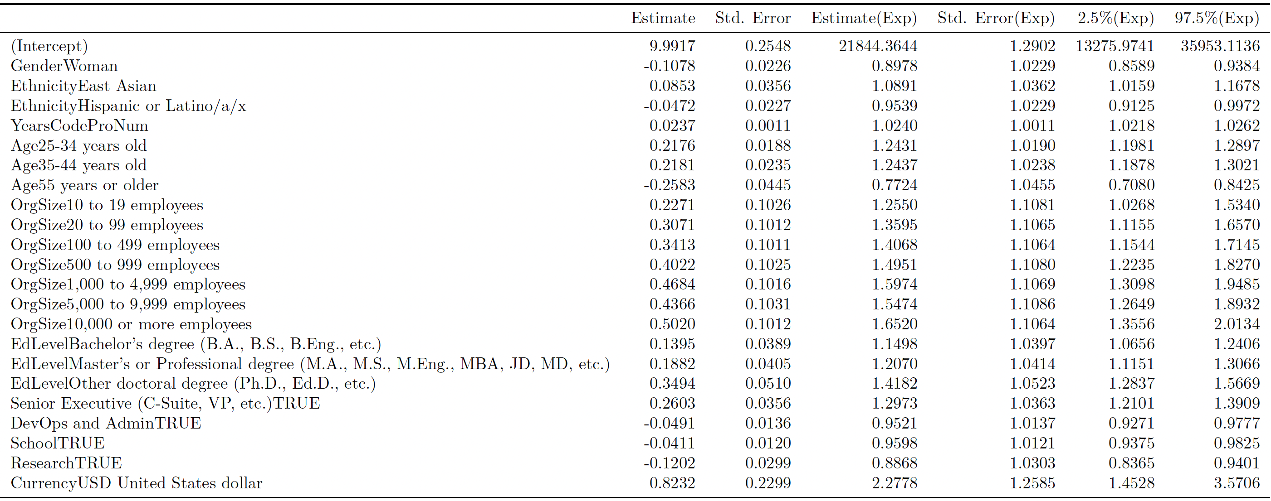
Interpretation
Fixed Effects
…
* Included only significant variables

Slide 11
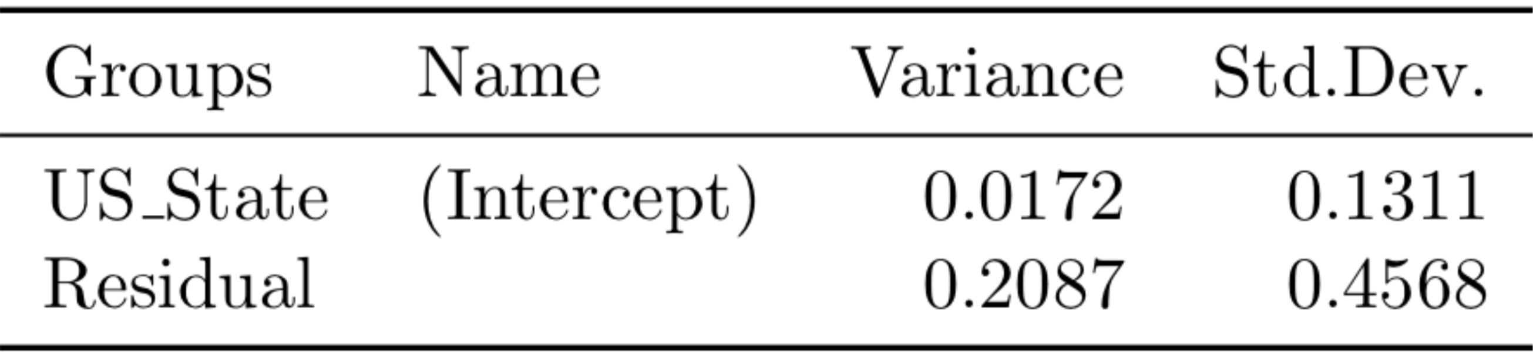
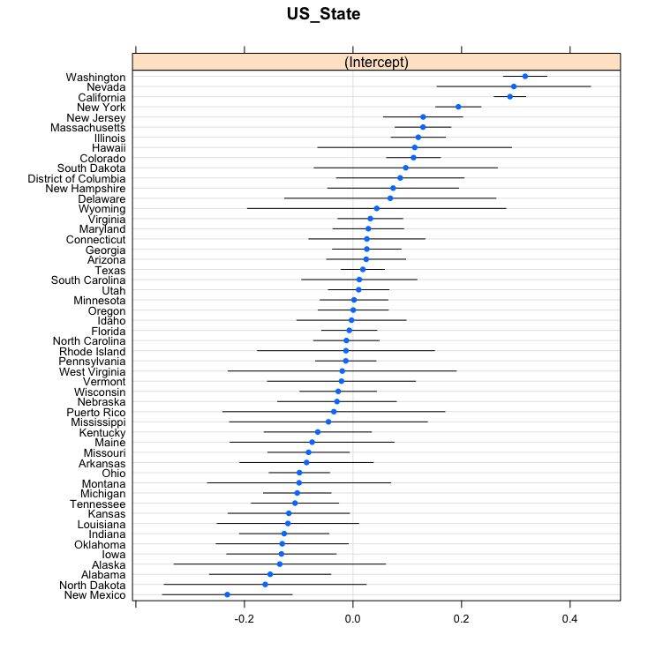
Interpretation
Fixed Effects
Random Effects
Holding all else constant:
Women earn 10% less than men
East Asians earn 8.9% more and Hispanics earn 4.6% less than White counterparts
Older people earn more than younger people until you hit 55
Get a doctorates degree (they earn 42% more than those without a higher education degree) but don’t do research work at a technology company (earning 11% less than developers)

Slide 12
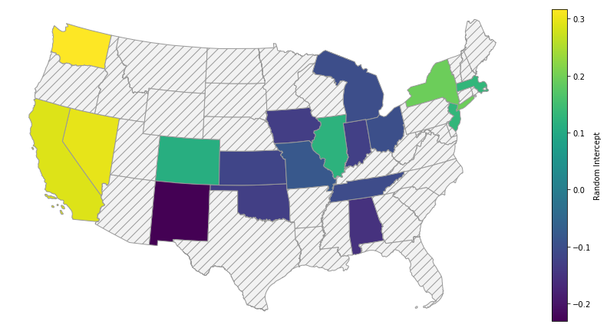
Interpretation
Geographical View

Slide 13


Next Steps
In the coming weeks…
Complete my missing data multiple imputations
Explore hierarchical model with random slopes by US_State
Look at how my model differs if group by $Ethnicity$ or $Gender$
Consider to incorporate any suggestions from you all ☺

Slide 14
This is a Title

